Slide 1

SESHADRI RAO GUDLAVALLERU ENGINEERING COLLEGE DEPARTMENT OF ELECTRONICS AND COMMUNICATION ENGINEERING
MAIN PROJECT ON
SPECTRUM SENSING FOR DATA TRANSMISSION IN WIRELESS COMMUNICATION
Under the Guidance of
Sri E. Vargil Vijay
Assistant Professor, Department of ECE
Presented by : B3
K. Meghana (19481A0493)
M. Sivaiah (20485A0412)
K. Leela Venkata Satya Sai Charan (19481A04B8)
K. Mahanth Venkata Sumanth (19481A04B4)

Slide 2
Contents
OBJECTIVE
ABSTRACT
PROPOSED MODEL
WORK FLOW
SOFTWARE USED
RESULTS
REFERENCES
SPECTRUM SENSING
FLOW CHART

Slide 3
Objective
The main objective of this project is to sense the wireless communication channel occupancy and to find whether channel is free or not. If the channel is free then it means primary user (PU) is not utilizing the channel then secondary user (SU) can utilize the channel and performance of the communication system in the presence of noise can be improved by utilizing the scarcely available spectrum.

Slide 4
Abstract
In present days as the wireless devices users have been enormously growing, the serviceable spectrum is not sufficient and as a result scarcity has been arising, and there is a necessity to use the spectrum in a more dexterous way for efficient wireless Communication system.
This project is about Spectrum sensing for efficient data transfer in Wireless Communications. Spectrum sensing is one of the methods for efficiently utilizing the spectrum. There are conventional methods existing based on energy detection for spectrum sensing now days, but through the advent of machine Learning, Sensing of spectrum can be performed in a more effective way. As machine learning based model can give best performance over conventional methods.
We are proposing a deep learning based spectrum sensing using Convolutional Neural Network(CNN) model under Gaussian environment for detecting the presence of primary user. This model will be very useful for resolve the spectrum scarcity issue in wireless Communications.

Slide 5
Spectrum Sensing
In the world of wireless communication, different devices and networks use specific frequency bands or channels to transmit and receive data.
Spectrum sensing is the process of detecting and identifying which frequency bands or channels are being used by active transmissions, and which ones are vacant or unused.
Need Of Spectrum Sensing
Efficient Spectrum Utilization
Interference Mitigation
Spectrum Sharing

Slide 6
Flow chart
Feature Extraction
Data Preparation Stage
Data Pre-Processing
Test Data
Training Data
Initialize The Model
The Model Training using ML
Spectrum Sensing Stage
Training Over
Spectrum Sensing

Slide 7
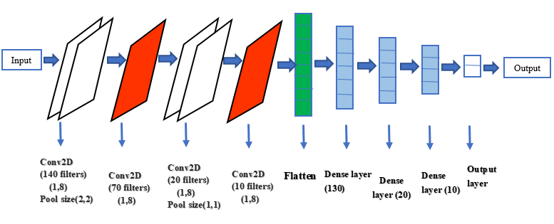
Proposed Model
The above diagram illustrates the working of the proposed model. The data set is the input to the convolution layer, which typically represents the pixel matrix of the data. Here selu activation function with lecun uniform and lecun normal kernel initializers have been proposed, and in the final stage for classification purpose sigmoid activation has been used with adadelta optimizer.

Slide 8
Why CNN:
One of the main advantages of CNNs is their ability to automatically learn hierarchical representations of the input data. CNNs use convolutional layers to apply filters to the input data, which are designed to capture local features such as edges and textures. These filters are learned during the training process, allowing the network to adapt to the specific characteristics of the input data. By using multiple convolutional layers, CNNs are able to learn increasingly abstract features that capture more complex patterns in the data.
Another advantage of CNNs is their ability to handle large amounts of data. CNNs can be trained on large datasets without overfitting.
In summary, CNNs are a powerful tool for classification tasks that require the automatic learning of hierarchical representations from large amounts of data

Slide 9
Work Flow
Data Pre Processing
Training Set Creation
CNN Architecture
Training
Testing
Deployment

Slide 10
Software Used
Python 3.2
Python is a high-level, interpreted programming language that is widely used for developing a variety of software applications. It was created in the late 1980s by Guido van Rossum and has since become one of the most popular programming languages in the world.
Python is used in a wide range of industries, including web development, data science, artificial intelligence, machine learning, scientific computing, and more. It is also widely used in education, as it provides a gentle learning curve and a large community of users and developers who can provide support and guidance.
Overall, Python is a versatile and powerful programming language that has become an essential tool for developers and scientists alike.

Slide 11
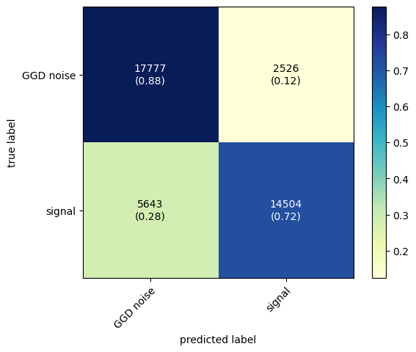
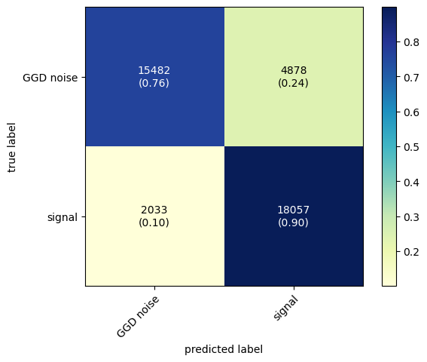
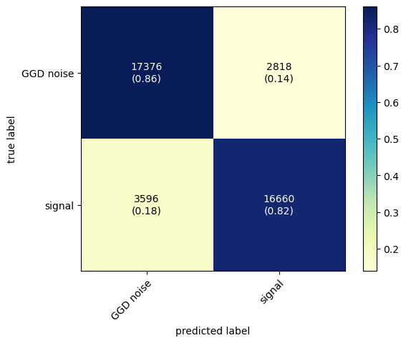
Results
A confusion matrix presents a table layout of the different outcomes of the prediction and results of a classification problem and helps visualize its outcomes. It plots a table of all the predicted and actual values of a classifier.
GELU
RELU
SELU
Fig: Confusion matrix of different activation functions

Slide 12
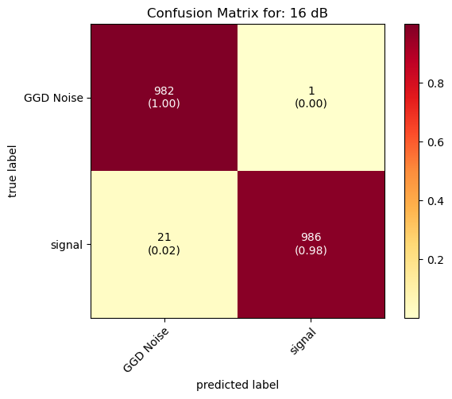
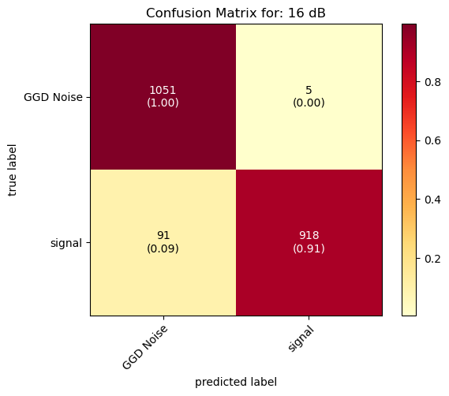

Confusion matrix of different activation functions at SNR 16 dB
RELU
GELU
SELU
Fig. Confusion matrix of different activation functions at 16 dB

Slide 13
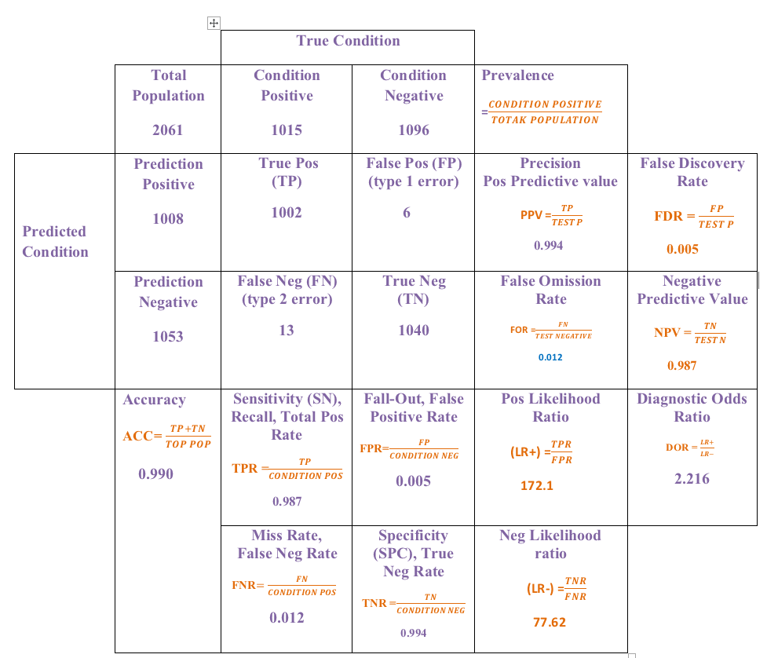
Calculations of Confusion Matrix

Slide 14
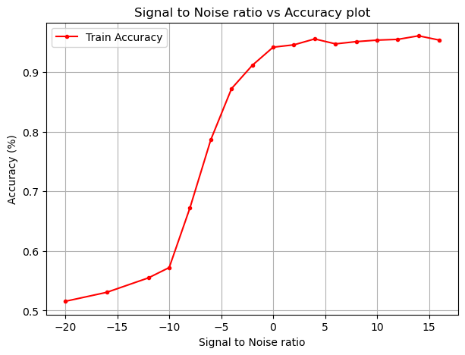
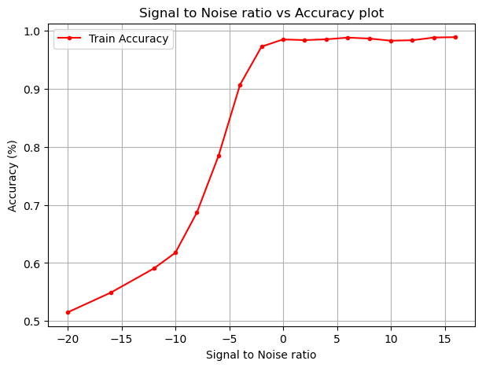
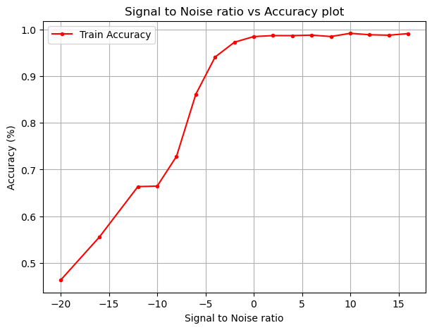
Classification accuracy vs SNR
GELU
RELU
SELU
Here the performance of a classification model on a dataset with binary labels can be summarized using various metrics, including TP, TN, FP, FN, accuracy, precision. Here the model has an accuracy of 0.99, indicating that it correctly predicts the class of 99% of the samples in the test set.

Slide 15
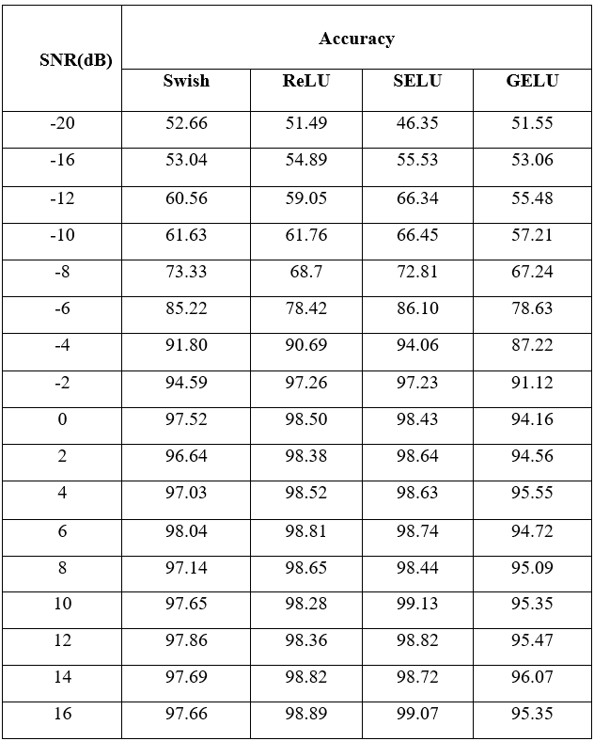
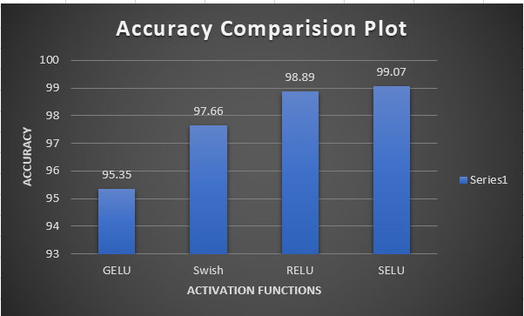
The Classification Precision Of different activation functions at various SNR values
Accuracy Comparison Plot at 16 dB
A 99% accuracy typically indicates that the model's predictions are correct for 99% of the samples in the dataset, without any noise or errors introduced during the evaluation process. This implies that the signal is present without any noise, and the model is able to make accurate predictions without any misclassifications.

Slide 16
Conclusion
Spectrum management issues have surfaced recently because of the expansion in wireless network users versus the availability of spectrum. In this case, TP, TN, FP and FN metrics used to determine whether or not a channel was free. The positive class represents the target condition while the negative class represents the nonoccurrence of that condition. When the channel strength is positive, it means the channel’s licensed user is actively engaged. If it is negative then it indicates that the channel was not utilized by licensed user. So allocation of channel can be done to unlicensed users if channel is not used.

Slide 17
References
[1] M. Saber, A. El Rharras, R. Saadane, A. H. Kharraz and A. Chehri, "An Optimized Spectrum Sensing Implementation Based on SVM, KNN and TREE Algorithms," 2019 15th International Conference on Signal-Image Technology & Internet-Based Systems (SITIS), Sorrento, Italy, 2019, pp. 383-389, doi: 10.1109/SITIS.2019.00068.
[2] Liu, Chang, et al. "Deep CM-CNN for spectrum sensing in cognitive radio." IEEE Journal on Selected Areas in Communications 37.10 (2019): 2306-2321.

Slide 18


